Slide 1
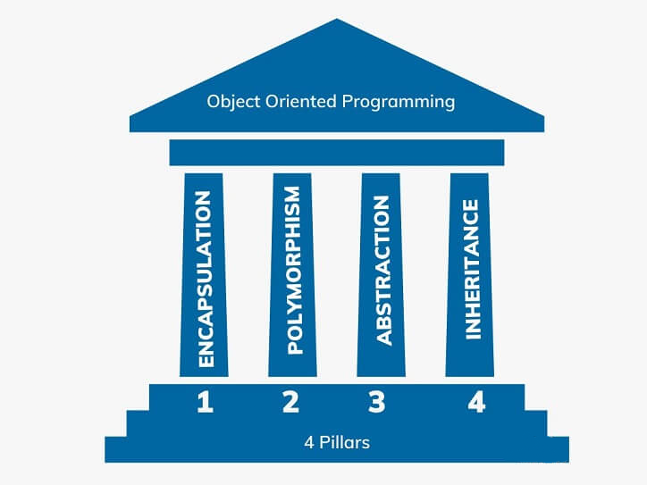
5CS019 - Object Oriented programming and design (OODP)
Inheritance and Polymorphism
Tutorial 05
Herald College, University of Wolverhampton

Slide 2
Topics Covered Today
Introduction to Inheritance
Method Overriding
Types of inheritance
Polymorphism
Method Overloading

Slide 3
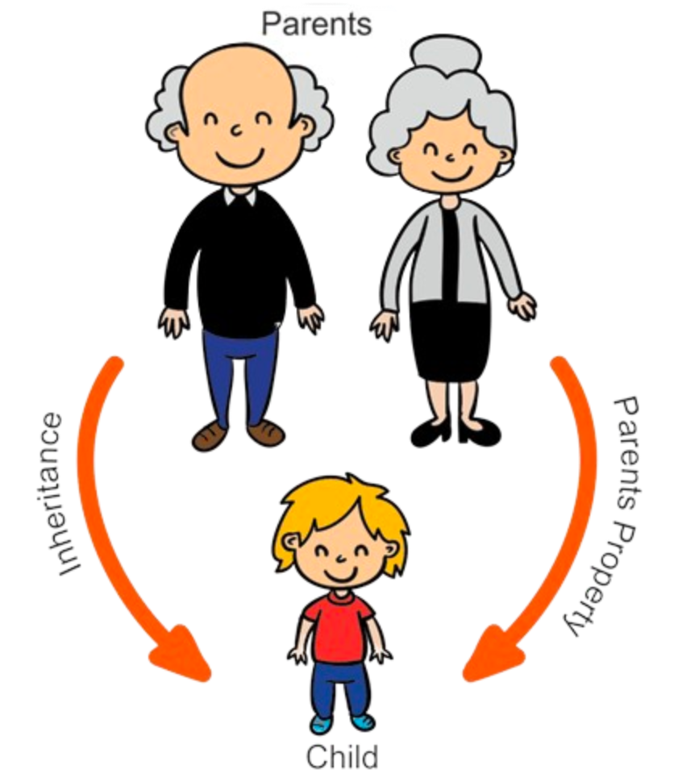
Inheritance
Inheritance in Java is a mechanism in which one object acquires all the properties of a parent object.
The extends keyword is used to perform inheritance in Java.

Slide 4
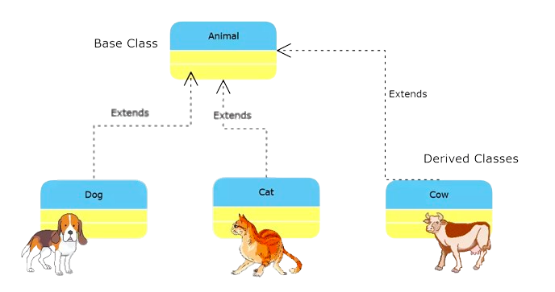
The parent class is known as Base Class / Super class
The child class is known as Derived class/ Sub Class

Slide 5
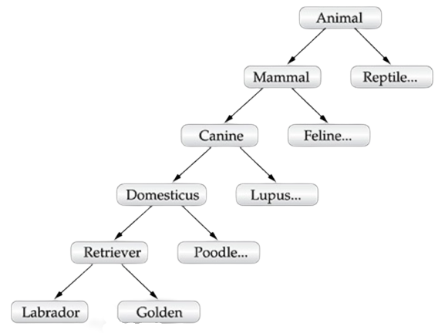

Slide 6
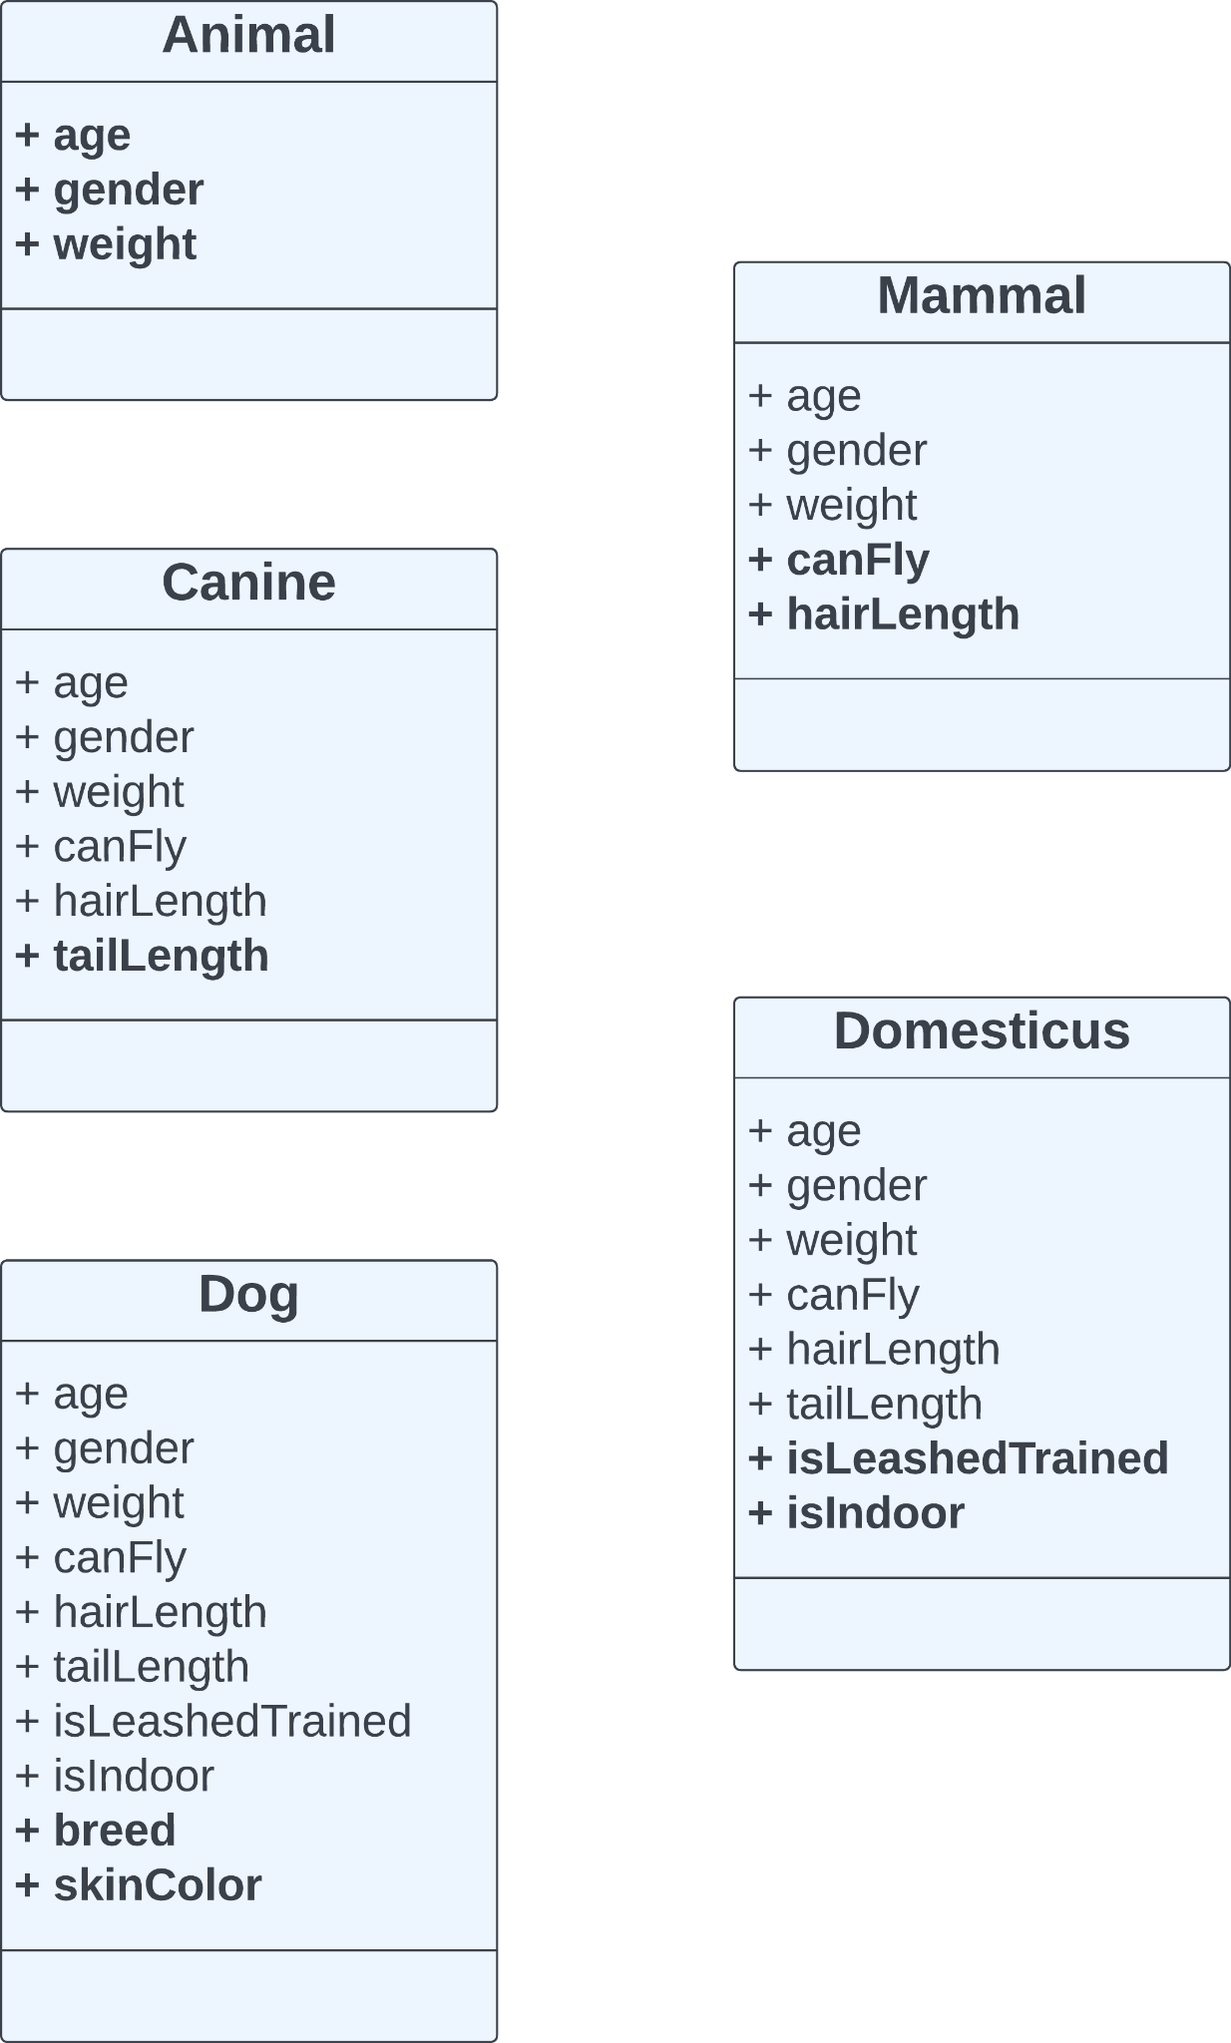
Before implementing Inheritance

Slide 7
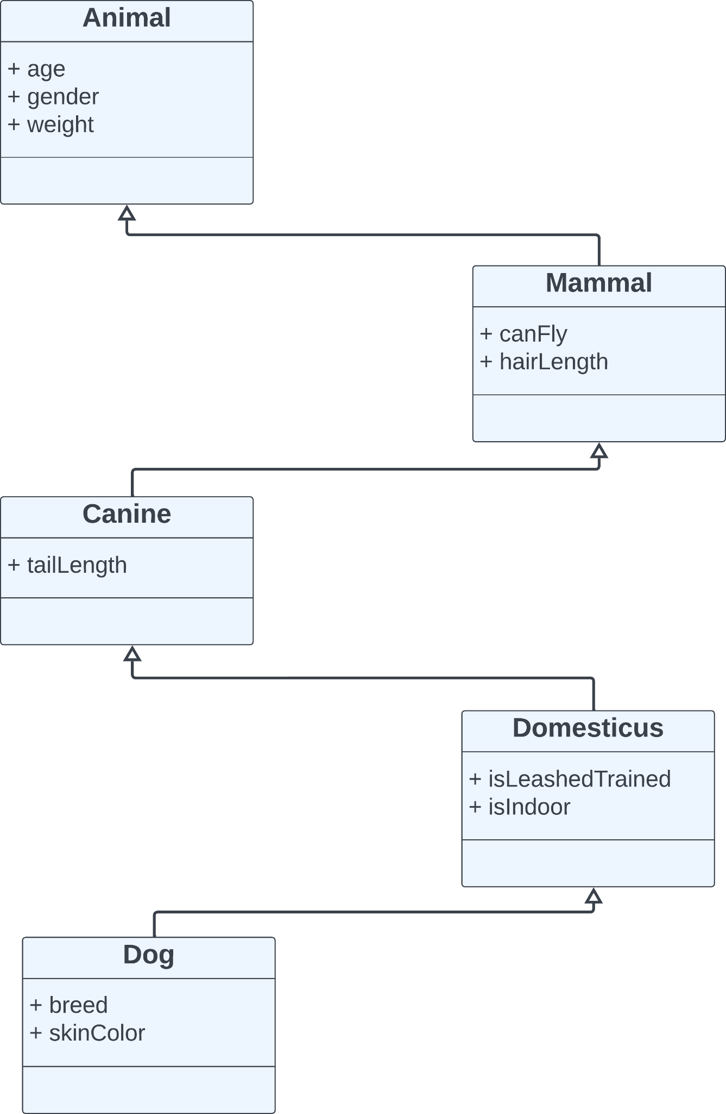
After implementing Inheritance

Slide 8
Advantages of Inheritance
Reusability: Inheritance help the code to be reused in many situations.
Save time & effort: the above concept of reusability achieved by inheritance saves the programmer time and effort.
Data hiding: the base class can decide to keep some data private so that it cannot be altered by the derived class.

Slide 9
Easy to understand: It is easy to understand large program with use of inheritance.
Maintainability: It is easy to debug a program when divided in parts. Inheritance provides an opportunity to capture the program.

Slide 10
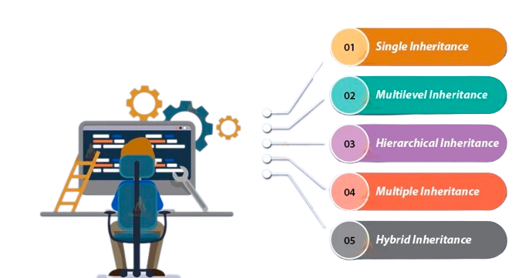
Types of Inheritance

Slide 11
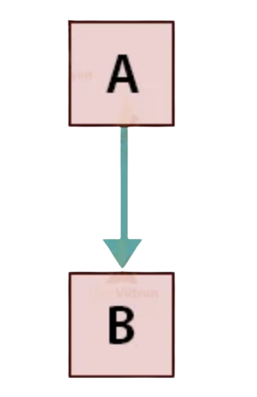
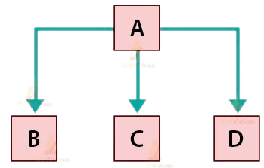
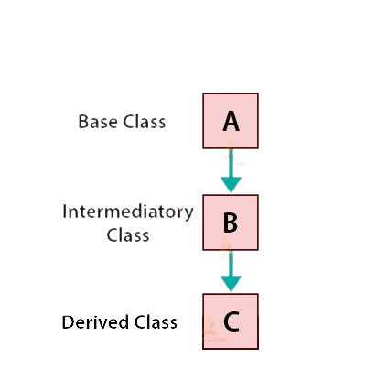
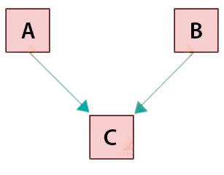
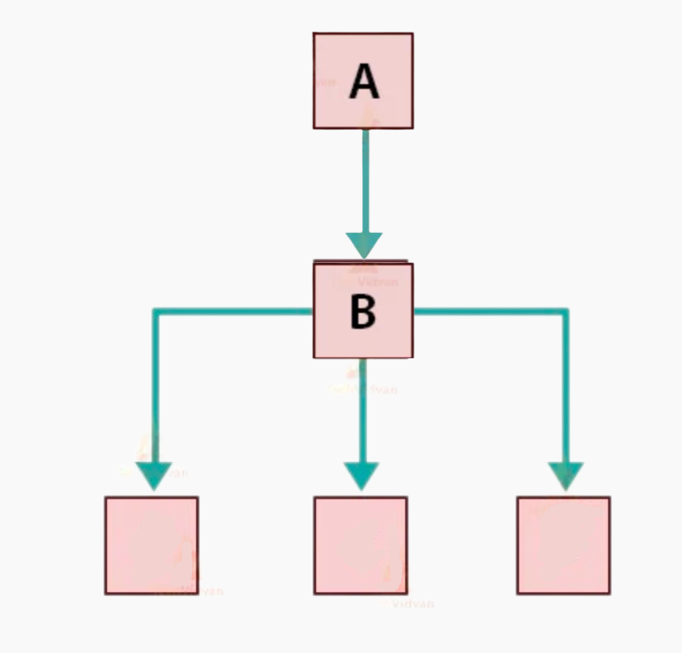
Single Inheritance
Hierarchical Inheritance
Multi-level
Inheritance
Multiple Inheritance
Hybrid Inheritance
C
D
E
(Java does not support
multiple inheritance)

Slide 12
Question 1:
How is code reuse achieved through inheritance?
Question 2:
What are the types of inheritance in Java? Why does Java not support multiple inheritance?

Slide 13
Task 1:
Define a class Person with attributes name and age.
Create a subclass Employee that inherits from Person and adds attributes employeeId, and salary.
Initialize an object employee1 using class Employee. Assign values to the attributes name, age, employeeId, and salary.

Slide 14
Task 2 :
Define a class Animal with attributes name, weight, color and age.
Create a subclass Dog that inherits from Animal and add an attribute breed and isIndoor.
Create a subclass Cat that inherits from Animal and add attribute height.

Slide 15
Task 3 (Method Overriding):
Add a method makeSound() to the class Animal defined in task 2.
Create subclasses Dog and Cat that inherit from Animal and override the makeSound() method to print the sound made by dog and cat respectively.

Slide 16
Task 4 (Multilevel inheritance) :
Create a class A with a method display() that prints "Class A".
Create a subclass B that inherits from A and overrides display() to print "Class B".
Create another subclass C that inherits from B and overrides display() to print "Class C".
Create an object of class C and call its display() method.

Slide 17
Task 5 (super() keyword in Java):
Implement a class Shape with attributes color and method printArea().
Create a subclass Rectangle that inherits from Shape and adds attributes length and width. Use super() to initialize the color attribute in the Rectangle constructor.
Create a subclass Square that inherits from Shape and adds attributes length. Use super() to initialize the color attribute in the Square constructor.

Slide 18
Task 6 (final keyword):
Define a class, “Animal” as a final class. Try creating a subclass “Dog” that inherits from class “Animal” and observe the result.
Define a class Vehicle as final with a method start(). Attempt to create a subclass Car that inherits from Vehicle and observe the result.

Slide 19
Polymorphism:
Polymorphism is an important concept of object-oriented programming. It simply means more than one form.
That is, the same entity (method or operator or object) can perform different operations in different scenarios.

Slide 20
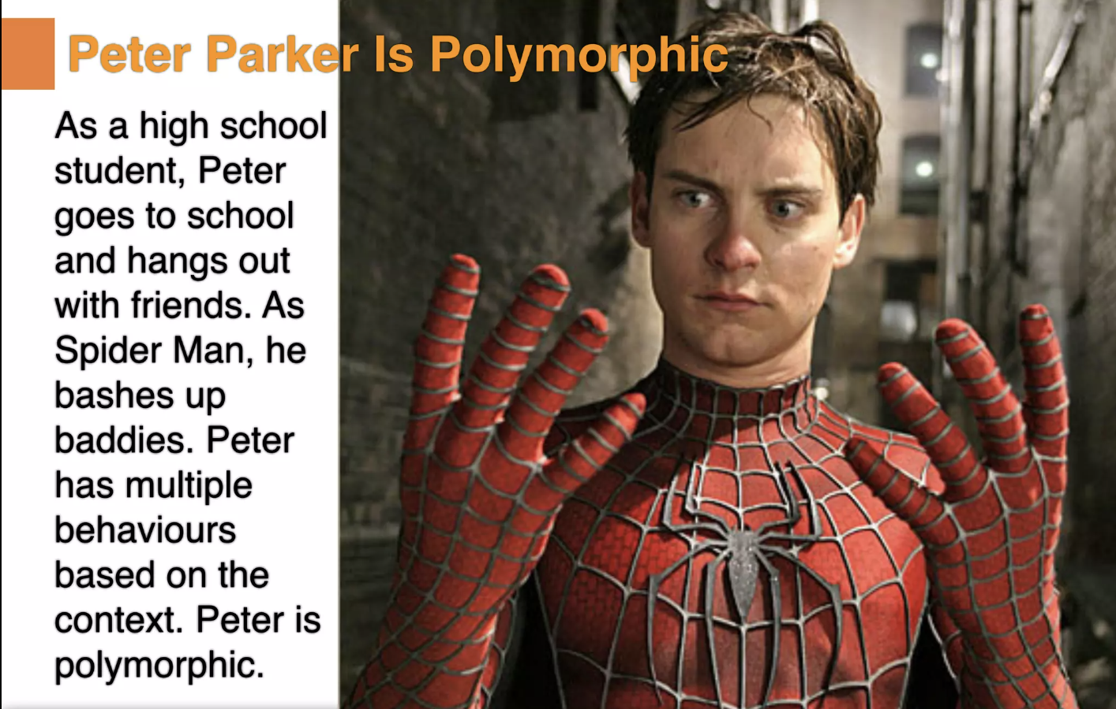

Slide 21
Task 7 (Method overloading):
Create a class AreaCalculator with method calculateArea() and perform the following tasks:
Create an overloaded method named calculateArea to compute and display the area of a rectangle using length and width.
Overload the calculateArea() method to calculate and display the area of a square using the side length.
Overload the calculateArea method again to calculate and display the area of a triangle using base and height.

